Slide 1

Collection Framework

Slide 2
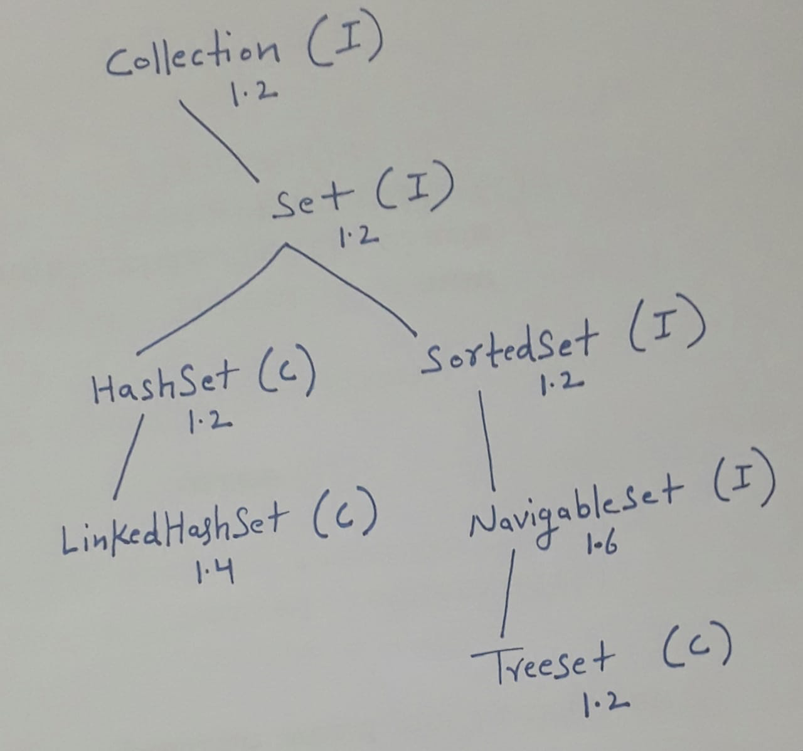

Slide 3
Set
Set is the child interface of Collection
If we want to represent group of individual objects as a single entity, where duplicates are not allowed and insertion order is not preserved then we should go for Set
Set interface doesn't contain any new methods so we have to use only Collection interface methods

Slide 4
HashSet
HashSet is defined using HashTable
Duplicates are not allowed
Insertion order is not preserved and all objects will be inserted based on Hash-code of objects.
Heterogeneous objects are allowed
null insertion is possible (only once)
Implements Serializable and Cloneable interface but not RendomAccess.
It is best choice if our frequent operation is Searching

Slide 5
Example
import java.util.HashSet;
public class Mytesting {
public static void main(String[] args) {
HashSet i = new HashSet<>();
System.out.println(i.add("neeraj")); //true
System.out.println(i.add("neeraj")); //false}
}

Slide 6
Example
import java.util.ArrayList;
import java.util.HashSet;
public class Mytesting {
public static void main(String[] args) {
ArrayList q = new ArrayList();
q.add("aaa");
q.add("bbb");
q.add(null);
q.add(10);
q.add("aaa");
HashSet i = new HashSet(q);
System.out.println(i);}}

Slide 7
Constructors of HashSet
HashSet h = new HashSet();
Creates empty HashSet.
Default initial capacity is 16
Default fill ration 0.75( load Factor)
HashSet h = new HashSet(int initialcapacity)
HashSet h = new HashSet(int initialcapacity, float loadfactor)
HashSet h = new HashSet(Collection c);
this constructor meant for internal conversion between collection objects

Slide 8
LinkedHashSet
It is based on Hash table + Linked list Data Structure (Hybrid data structure)
Child interface of HashSet
Introduced in version 1.4
Insertion order is preserved
Duplicates are not allowed

Slide 9
SortedSet
It is the child interface of set
If we want to present a group of individual objects according to some sorting order and duplicates are not allowed then we should go for sorted Set

Slide 10
SortedSet Methods
Object first();
Returns first element of the SortedSet
Object last();
Returns last element of the SortedSet
SortedSet headSet(Object obj)
Returns Sortedset whose elements are less than obj
SortedSet tailSet(object obj)
Returns SortedSet whose elements are >=obj

Slide 11
SortedSet Methods
SortedSet subSet(Object obj1, Object obj2);
Returns SortedSet whose elements are >=obj1 and <obj2
Comparator comparator()
Returns comparator object that describes underlying sorting technique. If we are using default natural sorting order then we will get null
The default natural sorting order for number is ascending order and for String is Alphabetical order

Slide 12
Example
import java.util.TreeSet;
public class Mytesting {
public static void main(String[] args) {
TreeSet obj = new TreeSet();
obj.add(10);
obj.add(90);
obj.add(70);
obj.add(60);
obj.add(30);
obj.add(80);
obj.add(20);
System.out.println(obj.first()); //10
System.out.println(obj.last()); // 90
System.out.println(obj.headSet(70));
//[10, 20, 30, 60]
System.out.println(obj.tailSet(60));
//[60, 70, 80, 90]
System.out.println(obj.subSet(20,70)); //[20, 30, 60]
}
}

Slide 13
TreeSet
The underlying data structure for TreeSet is Balanced Tree
Duplicate Objects are not allowed
All objects will be inserted according to some sorting order.
Heterogeneous objects are not allowed. If we trying to insert heterogeneous object it will throw run time exception class cast exception
null insertion is allowed but only once(1.6 version)

Slide 14
TreeSet Constructors
TreeSet T = new TreeSet();
Creates an empty TreeSet object where elements will be inserted according to default natural sorting order.
TreeSet T = new TreeSet(Comparator c)
Creates an empty TreeSet object where elements will be inserted according to customised sorting order
TreeSet T = new TreeSet(SortedSet s)
TreeSet T = new TreeSet(Collection c)

Slide 15
Example
import java.util.TreeSet;
public class Mytesting {
public static void main(String[] args) {
TreeSet obj = new TreeSet();
obj.add("A");
obj.add("a");
obj.add("B");
obj.add("Z");
obj.add("U");
// obj.add(80); // ClassCastException
// obj.add(null); // NullPointerException
System.out.println(obj);

Slide 16
Map Interface
Map is not child interface of Collection
If we want to represent group of objects as key value pair then we should go for Map.
Duplicate keys are not allowed but values can be duplicate.
Each key value pair is called entry, hence map is considered as collection of entry objects
Collection related terminology not applicable for the Map because collections talks about simple objects but Map talks about (key value) pairs.
Map contain its own specific methods so collection methods we cannot use because concept is different.

Slide 17
Map Interface Methods
Object put(Object key,Object value)
putAll(Map m)
get(key)
If You know the key this method is used it will return the value if specified key is mapped
remove(key)
To remove one key value pair
IsEmpty()
Size()
clear()
containsKey(key)
Whether a key is available in this map or not
containsValue(value)
Whether a value is available in this Map or not

Slide 18
Methods----
These methods are considered as collection view of map
set keySet();
collection Values();
set entrySet()

Slide 19
Map Interface Methods
A map is group of key value pair and each value pair is called an entry hence map is considered as a collection of entry objects
Without existing map object there is not chance of existing entry object hence entry interface is defined inside Map interface
The following are the Entry specific methods we can apply only on entry object.
Object getKey()
Object getValue()
Object setValue()

Slide 20
HashMap
The underlying data structure is HashTable
Insertion order is not preserved it is based on hashcode of keys
Duplicate keys are not allowed but duplicate values are allowed
Heterogeneous keys and values are allowed
Allows one Null key and multiple null values
Implements Serialisable , Cloneable but not RendomAccess
Best choice if our frequent operation is search operation
HashMap not Syncronized

Slide 21
HashMap
The underlying data structure is HashTable
Insertion order is not preserved it is based on hashcode of keys
Duplicate keys are not allowed but duplicate values are allowed
Heterogeneous keys and values are allowed
Allows one Null key and multiple null values
Implements Serialisable , Cloneable but not RendomAccess
Best choice if our frequent operation is search operation
HashMap not Syncronized

Slide 22
Constructors of HashMap
HashMap h = new HashSet();
HashMap h = new HashSet(int initialcapacity)
HashMap h = new HashSet(int initialcapacity, float loadfactor)
HashMap h = new HashSet(Map c);

Slide 23
LinkedHashMap
It is the child class of HashMap
It is exactly same as hashmap (including Methods and constructors)
Underlying data structure is a combination of LinkedList + HashTable (hybrid data structure)
Insertion order is Preserved
Introduced in java 1.4 version

Slide 24
SortedMap
SortedMap is child interface of Map
If we want to represent group of objects as key value pairs according to some Sorting order of keys then we should go for sorted Map.
Sorting is based on the key not based on value

Slide 25
SortedMap specific Methods
SortedMap define the following specific methods
Object first();
Object last();
SortedSet headMap(Object o);
SortedSet tailMap(Object o);
SortedSet subMap(Object o1,Object2 );
Comparator comparator();
Default natural Sorting return null

Slide 26
TreeMap
The data structure used in TreeMap RED-BLACK Tree.
Insertion order is not preserved and it is based on some sorting order of keys
Duplicate keys are not allowed but duplicate values are allowed
If we are depending on default natural sorting order then keys should be homogeneous and comparable otherwise we will get runtime exception saying class cast exception
If we are defining our own sorting by comparator then keys need not be homogeneous and comparable. We can take heterogeneous non comparable objects also
Null acceptance not available after 1.6 version only for keys. But for values we can use null any number of times. There is not restriction whether is 1.6 version or 1.7 version

Slide 27
TreeMap Constructors
TreeMap T = new TreeMap();
Creates an empty TreeMap object where elements will be inserted according to default natural sorting order.
TreeMap T = new TreeMap(Comparator c)
Creates an empty TreeSet object where elements will be inserted according to customised sorting order
TreeMap T = new TreeMap(Map m)
TreeMap T = new TreeMap(SortedMap m)

Slide 28
Example
import java.util.Comparator;
import java.util.TreeMap;
// implementation of custom sorting
public class TreeMapExample {
public static void main(String args[])
{
TreeMap t = new TreeMap(new MyCom());
t.put("aaa",10);
t.put("bbb",20);
t.put("ccc",30);
t.put("ddd",40);
System.out.println(t);
}}
class MyCom implements Comparator
{
@Override
public int compare(Object o1, Object o2) {
// TODO Auto-generated method stub
String s1 = o1.toString();
String s2 = o2.toString();
return s2.compareTo(s1);
}}

Slide 29
Assignment
Akshay Kumar is in trouble. He has a string and wants to find
and display the duplicate occurrences of word in the string

